Slide 1

Effective Communication Skills
Week 4
Johari Window &
Personality Types Models
Rajendra Singh

Slide 2
Week 4 Agenda
01
Johari Window and its Application
02
Personality Types Model - DISC
03
Personality Types Model – Myers Briggs
04
Effective Team Building

Slide 3
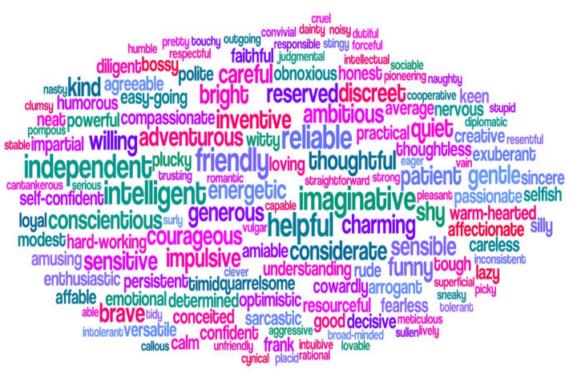
Johari Window
Joseph Luft and Harry Ingham developed the model in 1955

Slide 4
Johari Window Communication Model
“
“
It gives a personal insight into oneself and others.
This technique paints a better picture about who we are from our subjective perspective and also from the lenses of others.
Do I know me?

Slide 5
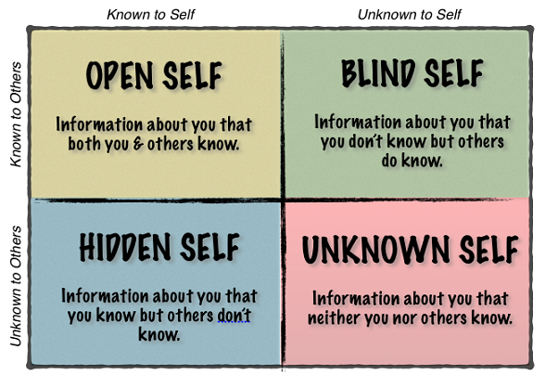
Johari Window

Slide 6
known
ME
unknown
Open Self
feedback
Blind Side
Others
Disclosure
discovery
Hidden Self
The Unknown
unknown
JoHari
Notes:
THIS IS AN ACTIVE SLIDE WHICH BUILDS UP THE COMLPETE MODEL

Slide 7

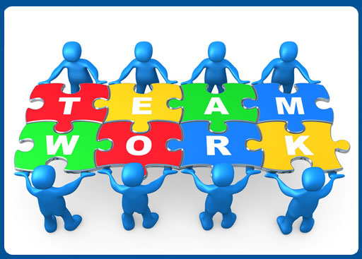
Johari Window Application
Team Building
Team Development
Personal Development
Communication
Improvement
Removes misunderstanding
Helps avoid or deal with conflicts
Helps increase productivity
Help adjust with team dynamics
Removes ambiguity about oneself or blank spots
Gives insight about areas of development
Helps to be in tuned to ones thoughts, emotions, and actions
Creates free and open environment among team members
Helps improve inter group relationships

Slide 8
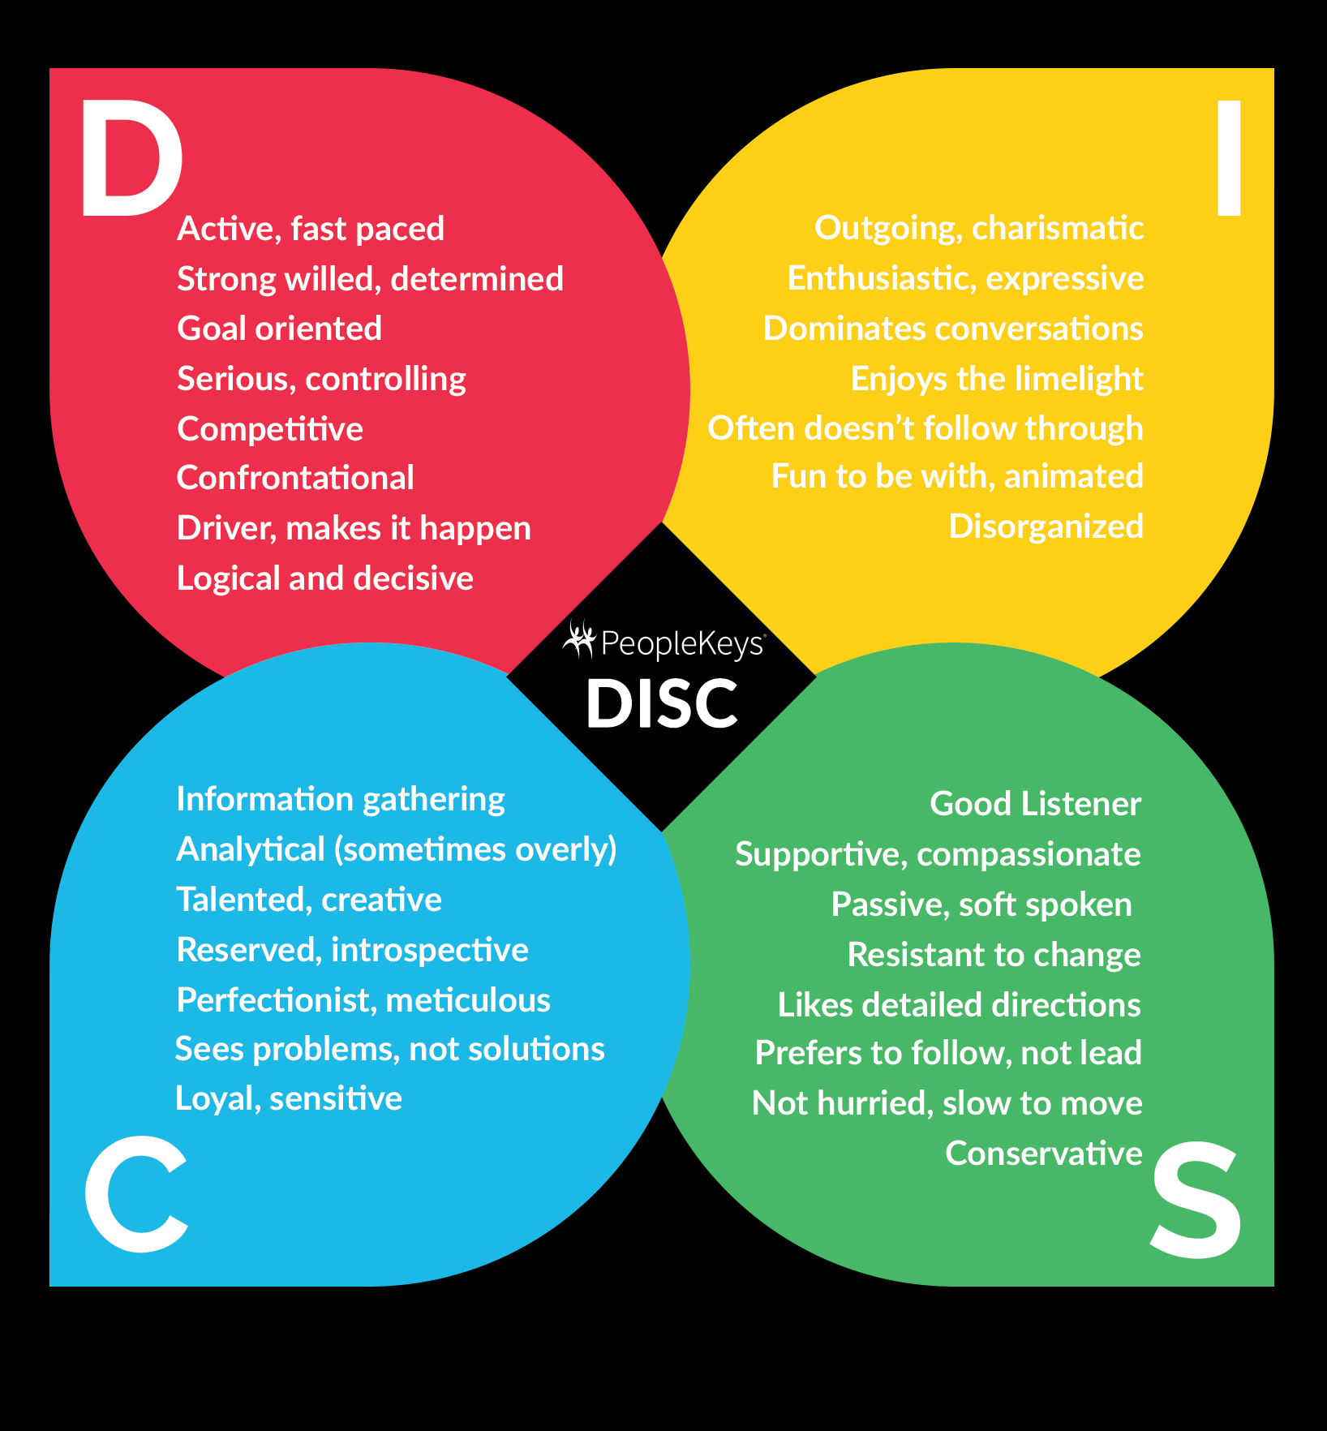
Personality Model
DISC
Dominance | Influence | Steadiness | Compliance

Slide 9
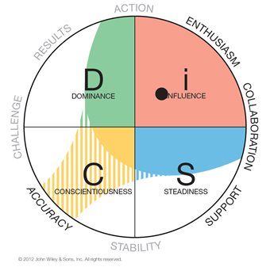
DISC Personality Test
Gives behavioral pattern, preference, and tendencies in different situations.

Slide 10
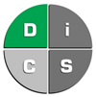
DISC Personality Model
Dominance
High “D” | Low “D”
Demanding | Cooperative
Forceful | Modest
Egocentric | Peaceful
Strong | Mild
Willed | Indifferent
Driving | Following
Determined | Unsure
Ambitious | Conservative
Aggressive | Agreeable
Pioneering | Cautious
Getting things Done with the personal Drive

Slide 11
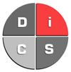
DISC Personality Model
Influence
High “I” | Low “I”
Convincing | Critical
Magnetic | Skeptical
Enthusiastic | Reserved
Persuasive | Factual
Warm/openness | Critical
Demonstrative | Logical
Trusting | Suspecting
Optimistic | Pessimistic
People person with rapport building and maintaining it for personal and professional development

Slide 12
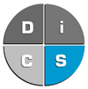
DISC Personality Model
Steadiness
High “S” | Low “S”
Calm\Relaxed\ Patient | Restless\Impatient\ Eager
Possessive | Cooperative
Predictable | Impulsive
Deliberate | Thinks “outside the box”
Stable | Changing
Consistent/ dependable | Welcome to different outcomes
Unemotional | Passionate
Reserved | Open to new ideas
Wants a steady pace, security, and do not like any sudden changes

Slide 13
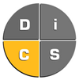
DISC Personality Model
Compliance
High “C” | Low “C”
Careful | Unconcerned with details
Cautious | Opinionated
Conforming | Nonconforming
Consistent | Inconsistent
Systematic | Unsystematic
Accurate | Arbitrary
Dependable | Changes are on-the-go
Sticks with rules, regulations, and structure. They can deliver consistent results.

Slide 14

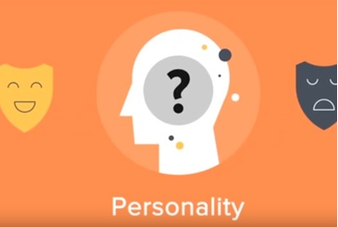
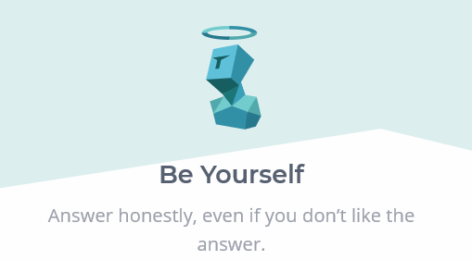
DISC Personality Test
Link

Slide 15
15 DISC Personality Profiles
The Achiever | The Coach | The Counselor | The Creative
The Enthusiast | The Evaluator | The Individualist | The Inspirational
The Investigator | The Objective Thinker | The Perfectionist | The Persuader
The Practitioner | The Result-Oriented | The Specialist
Enjoys competition, challenges, comfortable working alone, calm controlled, independent, and uninhibited.
Wants peace, harmony, working with other people, helpful, and adaptable.
Prefers to let others initiate action, interested in other people, calm, controlled, and feel restrained under rules and restriction.
Authoritative, resourceful, ambitious, comfortable working alone, pushing limits, and avoid taking risks.
Easy going, congenial, people friendly, avoid repetitive work and working alone, and welcomes changes.
Goal oriented, seeking recognition, people friendly, avoid repetitive work, and do not like risky deals.
Thrive in competition and challenge, seeking, avoid repetitive work, and independent.
Goal oriented, cooperating, enthusiastic, optimistic, pushing limits, and feel restrained by rules and regulations.
Focused, goal oriented, independent, conforming to rules and regulations.
Wants peace, harmony, independent, avoid repetitive work, and passive.
Strive to create structured and harmonious environment, independent, patient, persistent, and following rules and regulations.
Direct, positive and optimistic in relationships, enthusiastic, pushing limits, and result oriented.
Easy going, seeking approval, calm, controlled, organized and orderly.
Controlling, direct with others, avoid repetitive work, and feel restrained by rules and regulations.
Reactive, independent, calm, and likes to follow plans.

Slide 16
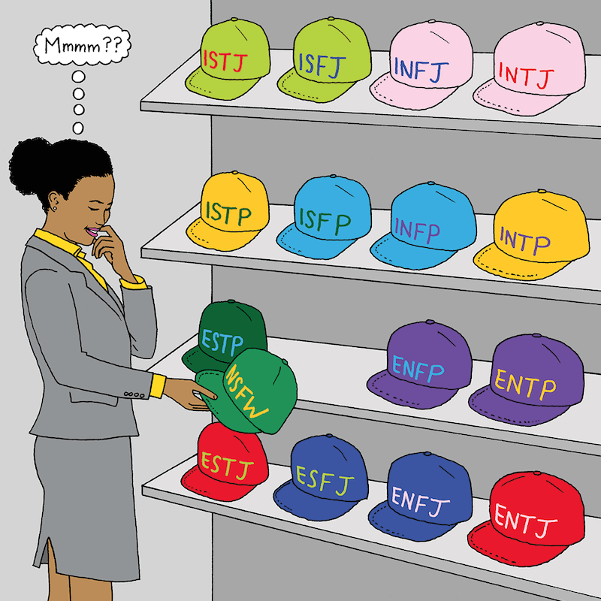
Myers-Briggs Type Indicator
Personality Model

Slide 17
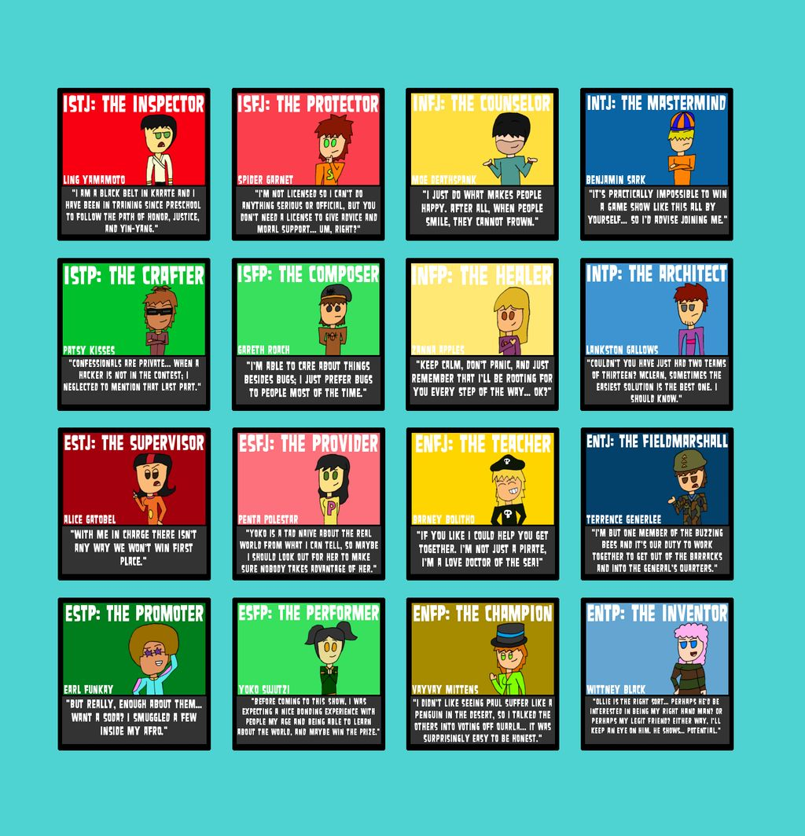
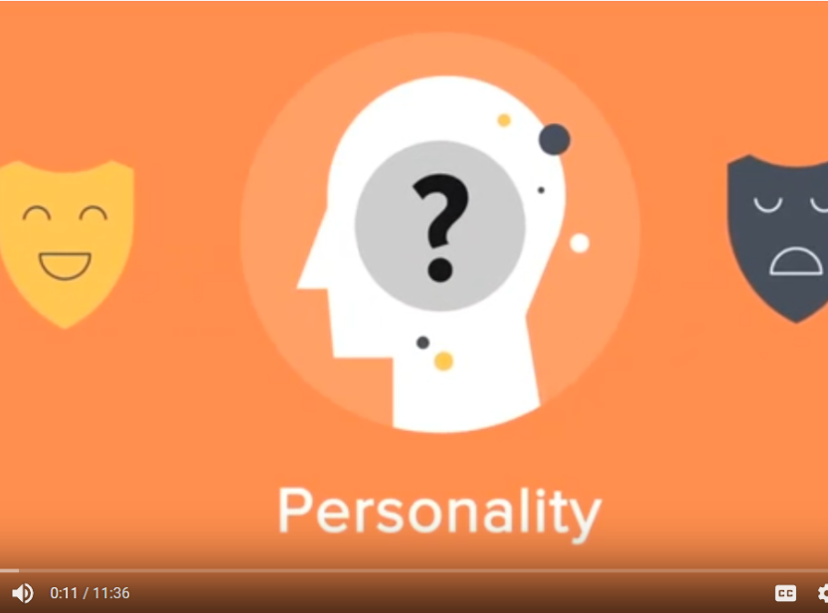
Myers-Briggs Personality Types
Link

Slide 18
Myers-Briggs Type Indicator
Attitude
Information Gathering
Structure Orientation
Decision Making
Introvert ‘I’
Intuition ‘N’
Extrovert ‘E’
Sensing ‘S’
Judging ‘J’
Thinking ‘T’
Perceiving ‘P’
Feeling ‘F’

Slide 19
Are you an Extrovert | Introvert?
Extroversion
Introversion
E
I
People person | Reserved
If you prefer to direct your energy to deal with people, things, situations, or “the outer world”
If you prefer to direct your energy to deal with ideas, information, explanations or beliefs, or "the inner world"
Do you feel comfortable with other people and feel energized with human interactions?
Or, do you feel drained with energy after dealing with people?

Slide 20
Do you rely on your Senses | Intuition?
Sensing
Intuition
S
N
Trust your experience | Instinct?
If you prefer to deal with facts, practicality, and prior experience in making your decision
If you prefer to deal with ideas, look into the unknown, to generate new possibilities, or to anticipate what isn't obvious
Are you more rigid and uncompromising with it comes to how things are done?
Or, are you open to changes and seek out a new prospect?

Slide 21
Do you rely on Thoughts | Feeling?
Thinking
Feeling
T
F
Trust your thoughts| Feelings
If you prefer to decide on the basis of objective logic, using an analytic and detached approach
If you prefer to decide using values and/or personal beliefs, or by what you believe is important or what you or others care about
Are you analytical, rational or logical?
Or, are you emotional, impulsive or spontaneous?

Slide 22
Are you methodical | flexible?
Judging
Perception
J
P
Are you organized | Flexible to change?
If you prefer your life to be planned, stable and organized
If you prefer to go with the flow, to maintain flexibility and respond to things as they arise
Do you like your daily activities (or life) all planned out and organized?
Or, do you feel more comfortable without deadlines? Do you enjoy the freedom in incorporating changes in your daily “schedule”?

Slide 23
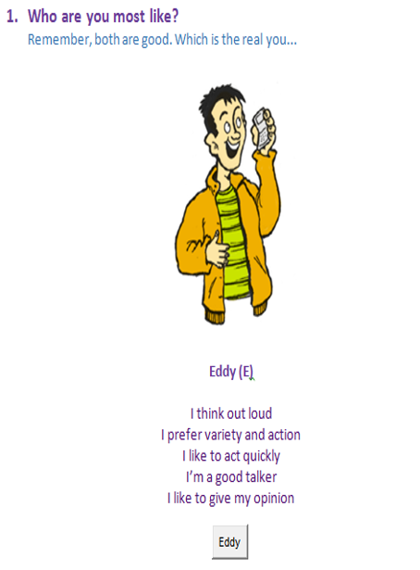
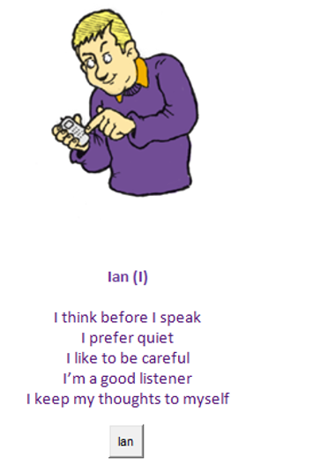
Introvert
Extrovert

Slide 24
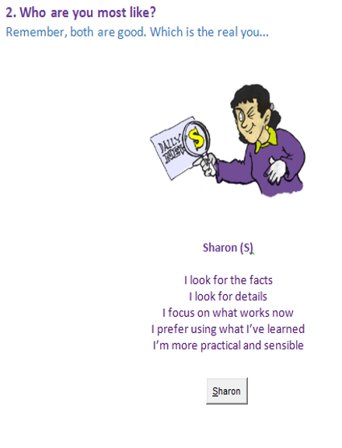
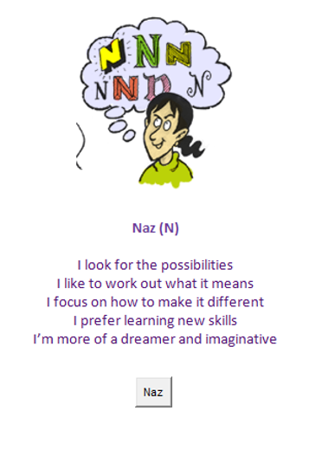
Intuition
Sensing

Slide 25
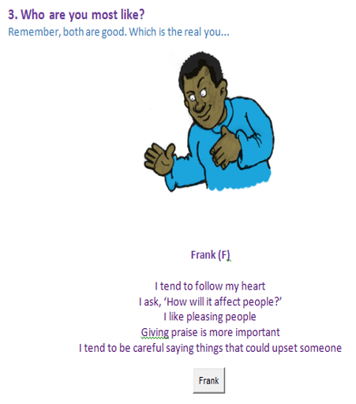
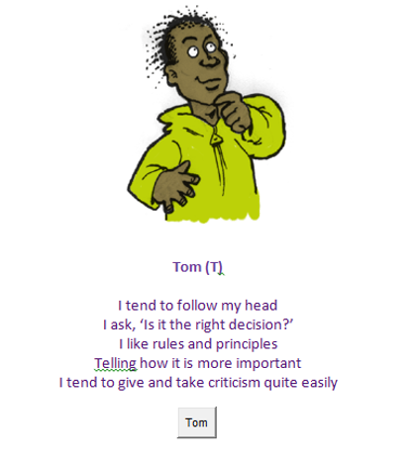
Feeling
Thinking

Slide 26
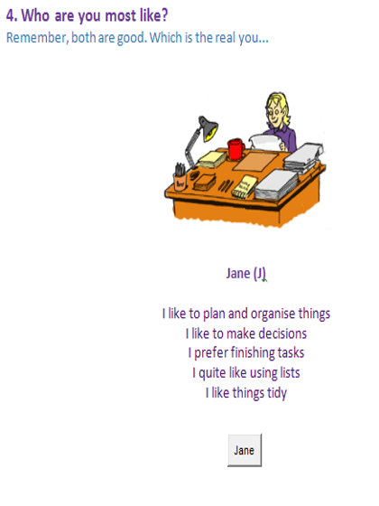
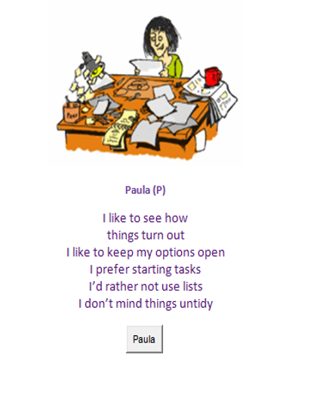
Perception
Judging

Slide 27
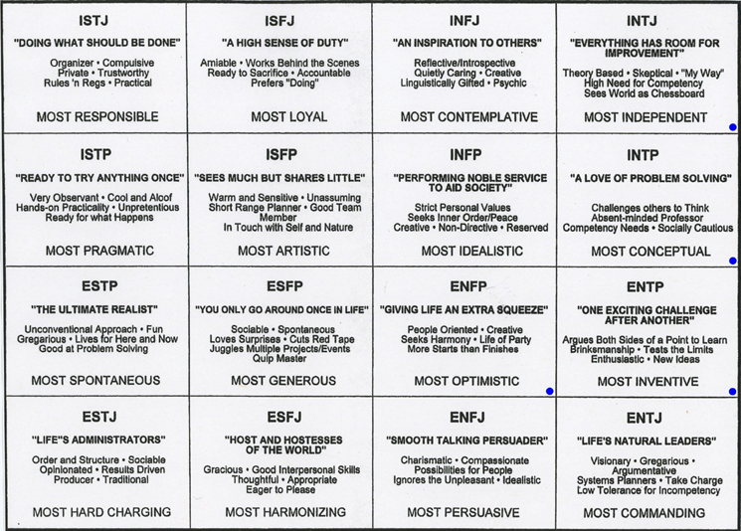
Myers-Briggs Type Indicator

Slide 28
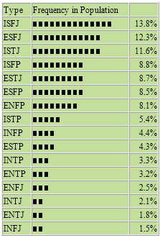
16 Myers-Briggs Personality Types
Link

Slide 29
Myers-Briggs Personality Test
Link

Slide 30

Team Management
Building a Functional Team

Slide 31






Team Management
Team Building Stages
Forming
For a new team, this is the first stage. Everything is new and fresh. Everyone is welcoming of each other, positive, exciting, and polite, although anxious.
Adjourning
At some point, a team will reach this stage. Completion of the team target either due to the project completion or restructuring of an organization.
Storming
Team members start to show their individuality and push the boundaries established during the Forming stage. Conflicts are highest in this stage.
Performing
The team is like a well oiled machine. It is without any team friction and aligned to the team goal. It is “we”, “our”, and “us” in this stage.
Norming
Team members are cohesive and cooperative. They have resolved their differences, respecting of one another as well as the authority of the leader. This stage may revert back partially or fully to Storming stage due to group dynamics

Slide 32
Team Management
Team Building Stages – A leader’s Role
Forming
If you are a team leader, your role in this stage is very critical. You need to help foster an open and inviting environment for all team members, including making roles and responsibilities clear, and establishing the objectives of the project.
Storming
You need to help solve or avoid any conflicts, including clarifying roles and responsibilities. and also making sure about your authority. Everyone needs to be clear about the team’s goal. Your team needs your support in dealing with any stressful situation and meeting deadlines.
Adjourning
Team members can maintain their networking and you, as a leader, can help bring back efficient team members in a new project.
Norming
Performing
Your role is important in taking your team to the state of cooperation and mutual understanding. Everyone in the team is social and open to meeting the goal of the team. A leader can facilitate individual growth through personal development of the team members.
A leader’s goal is to maintain this stage through dedication to the team, cooperation, support, and constructive feedback. There is synergy in the team and the team is up on par with the goal.

Slide 33
Thank you
Week 4
Personality Types & Team Management

